Slide 1
base_high
Pipeline: High
Vessel Pathway: Base
Port Pathway: Base

Slide 2
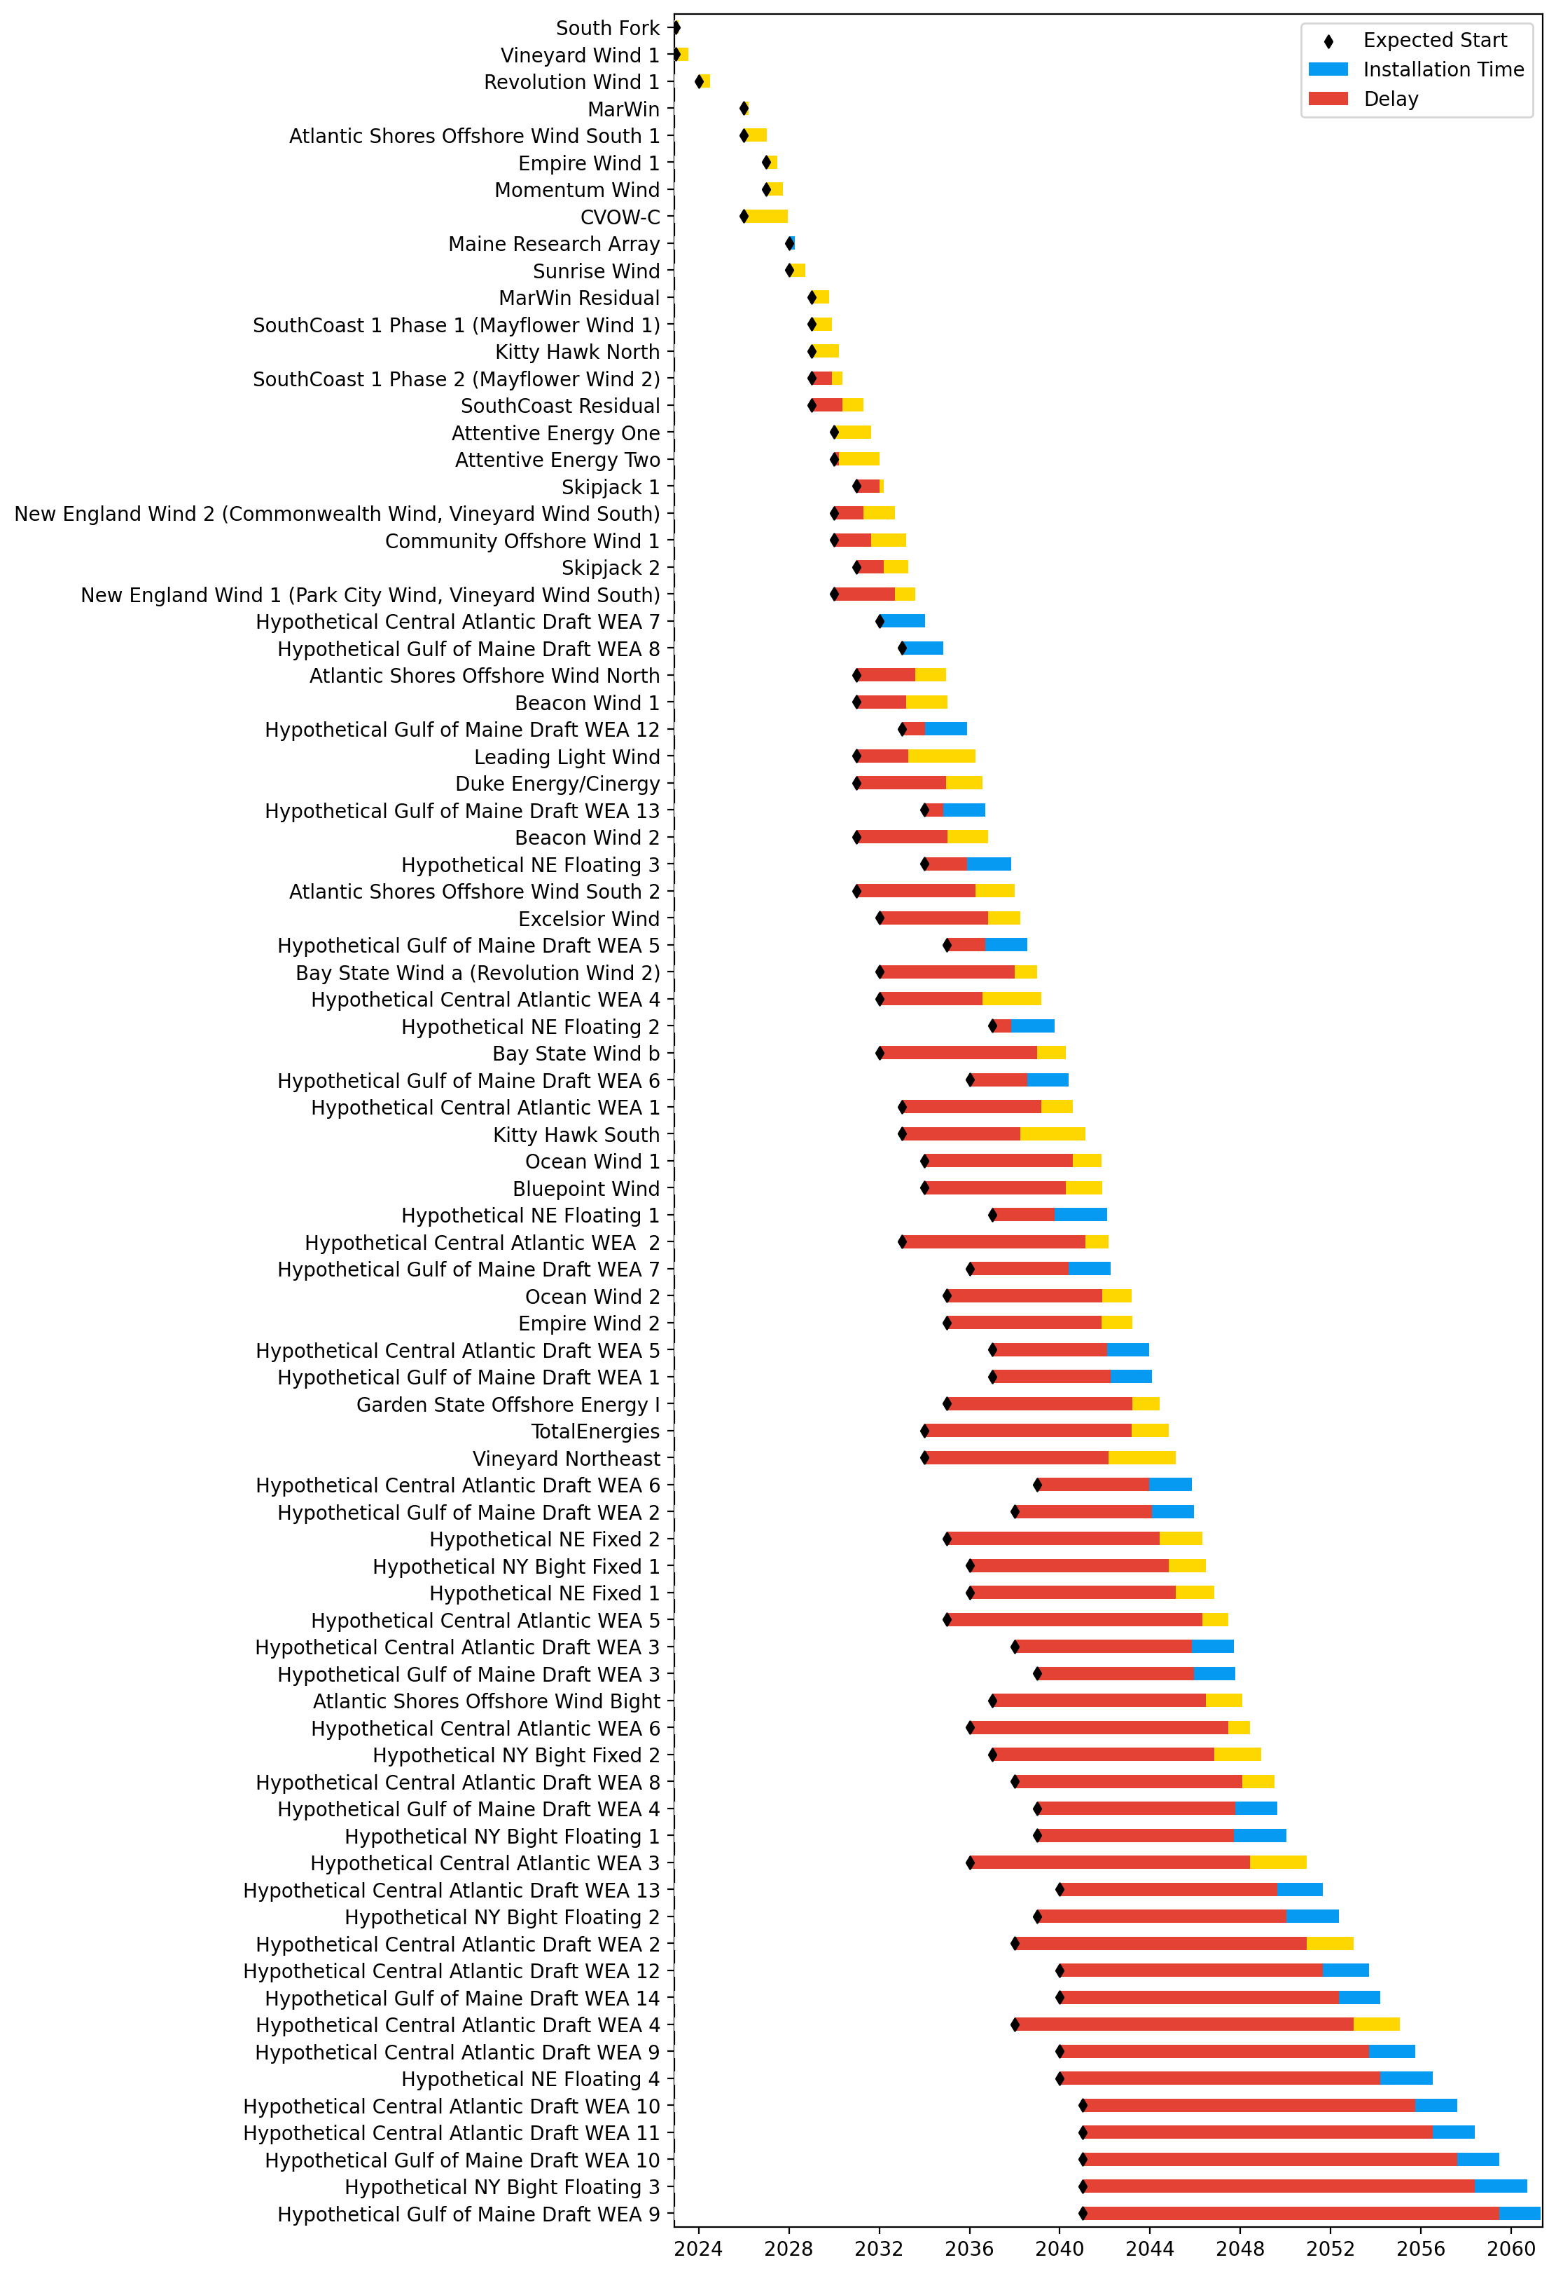
Full Gantt

Slide 3
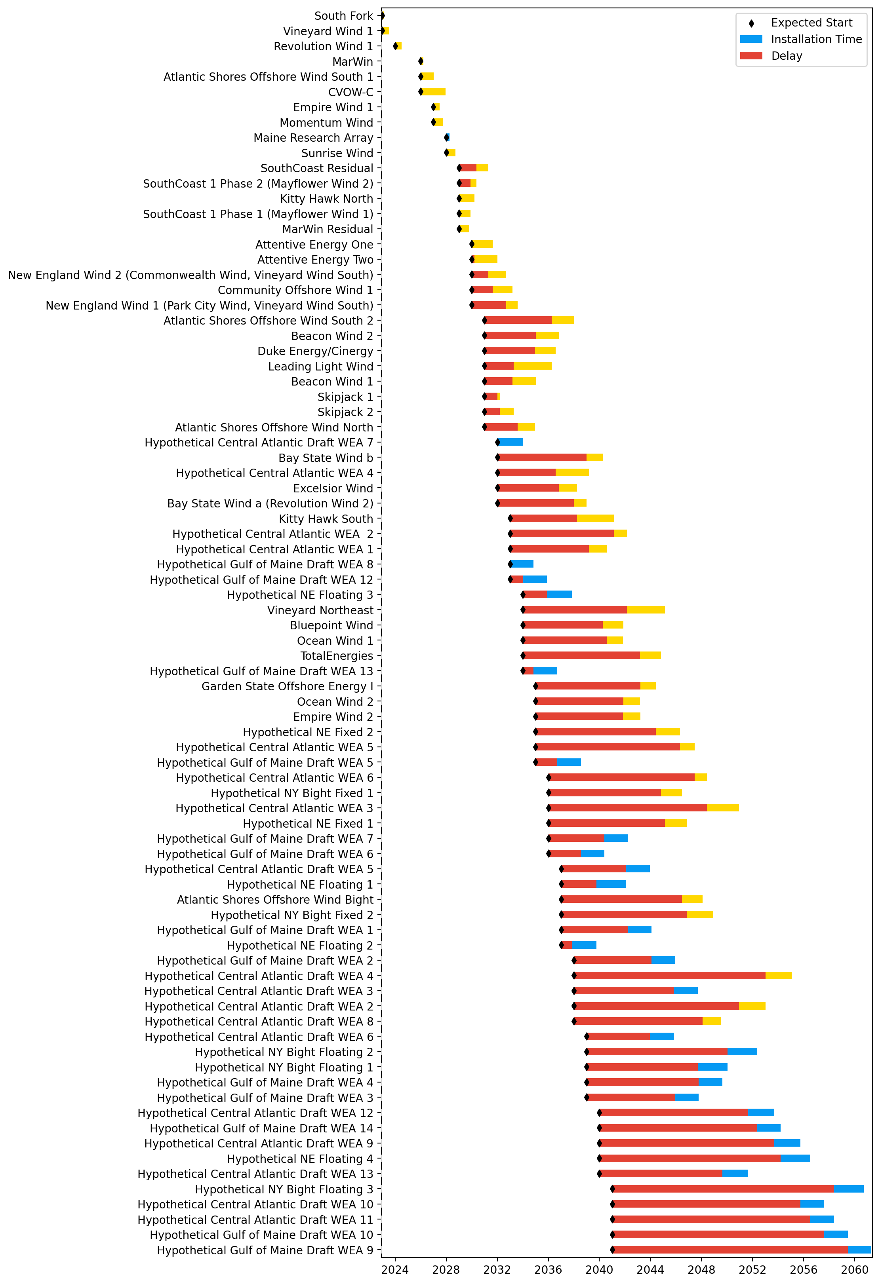
Sorted Full Gantt

Slide 4
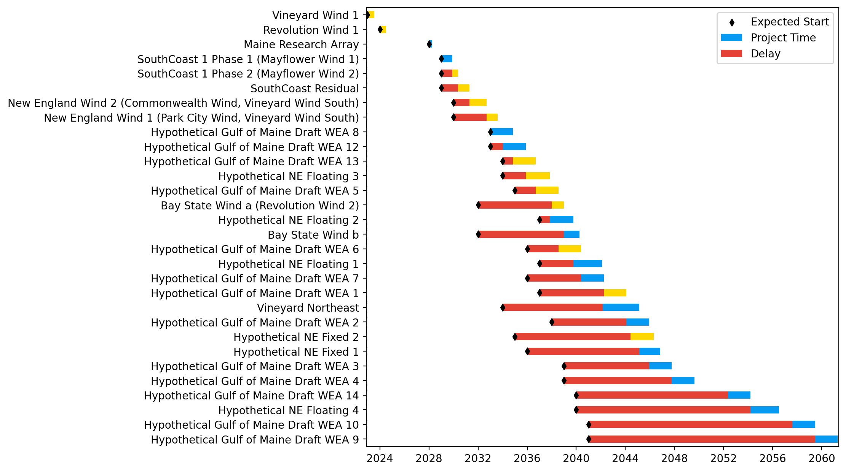
New England Gantt

Slide 5
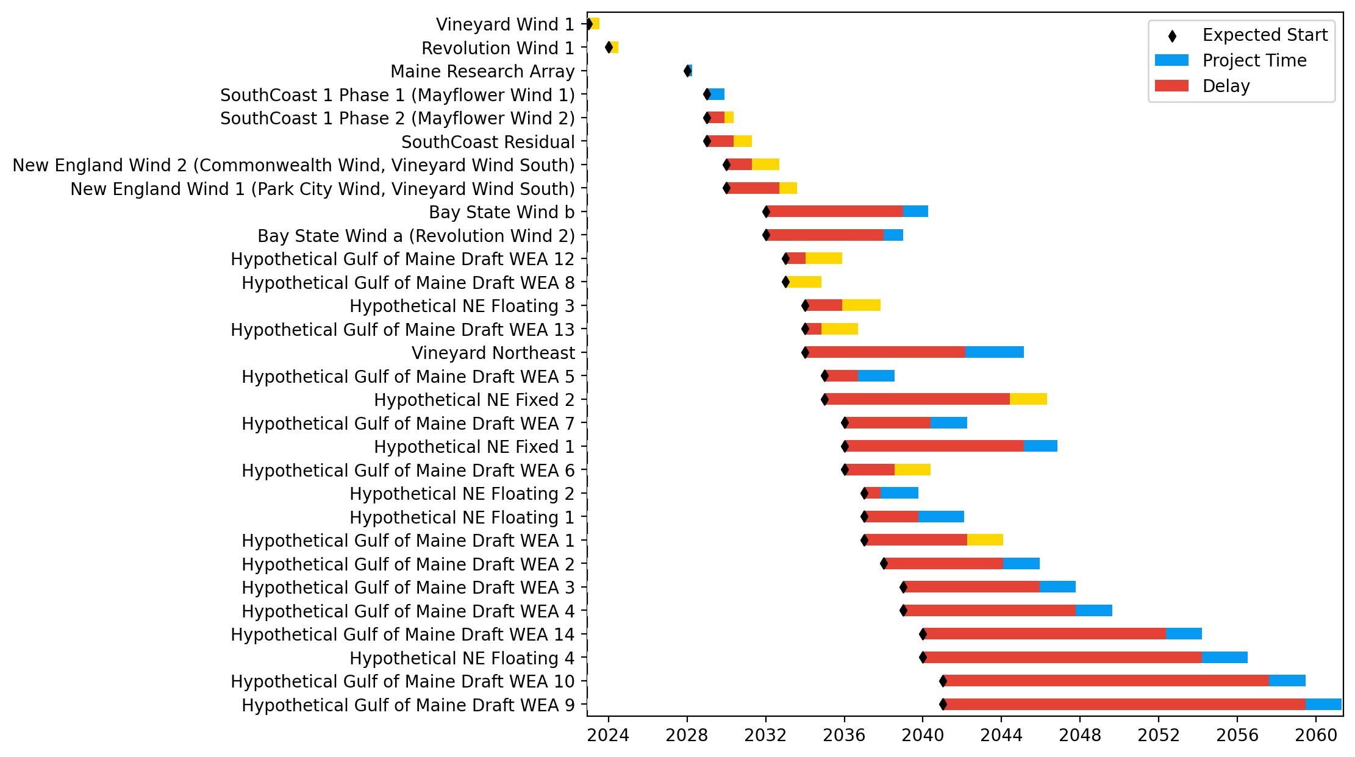
Sorted New England Gantt

Slide 6
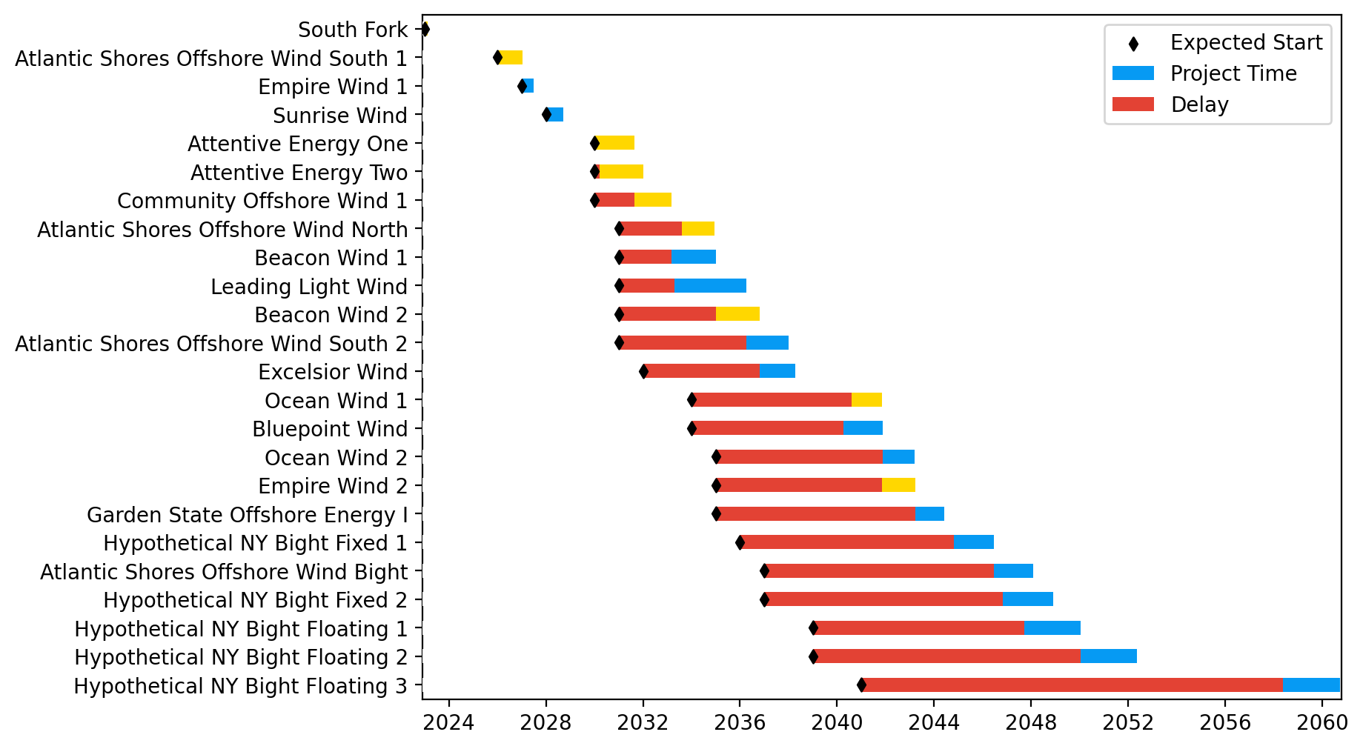
New York/New Jersey Gantt

Slide 7
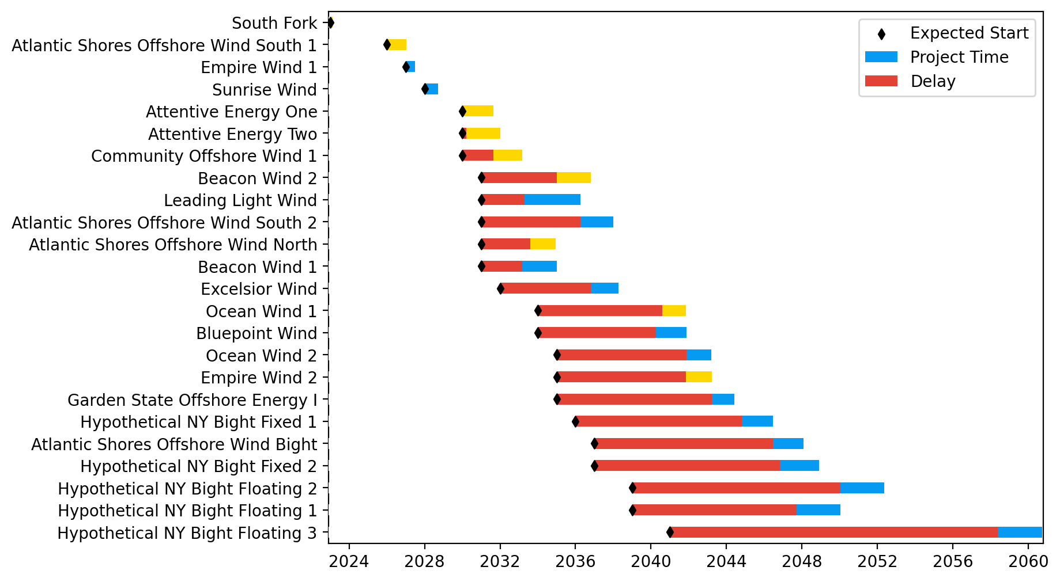
Sorted New York/New Jersey Gantt

Slide 8
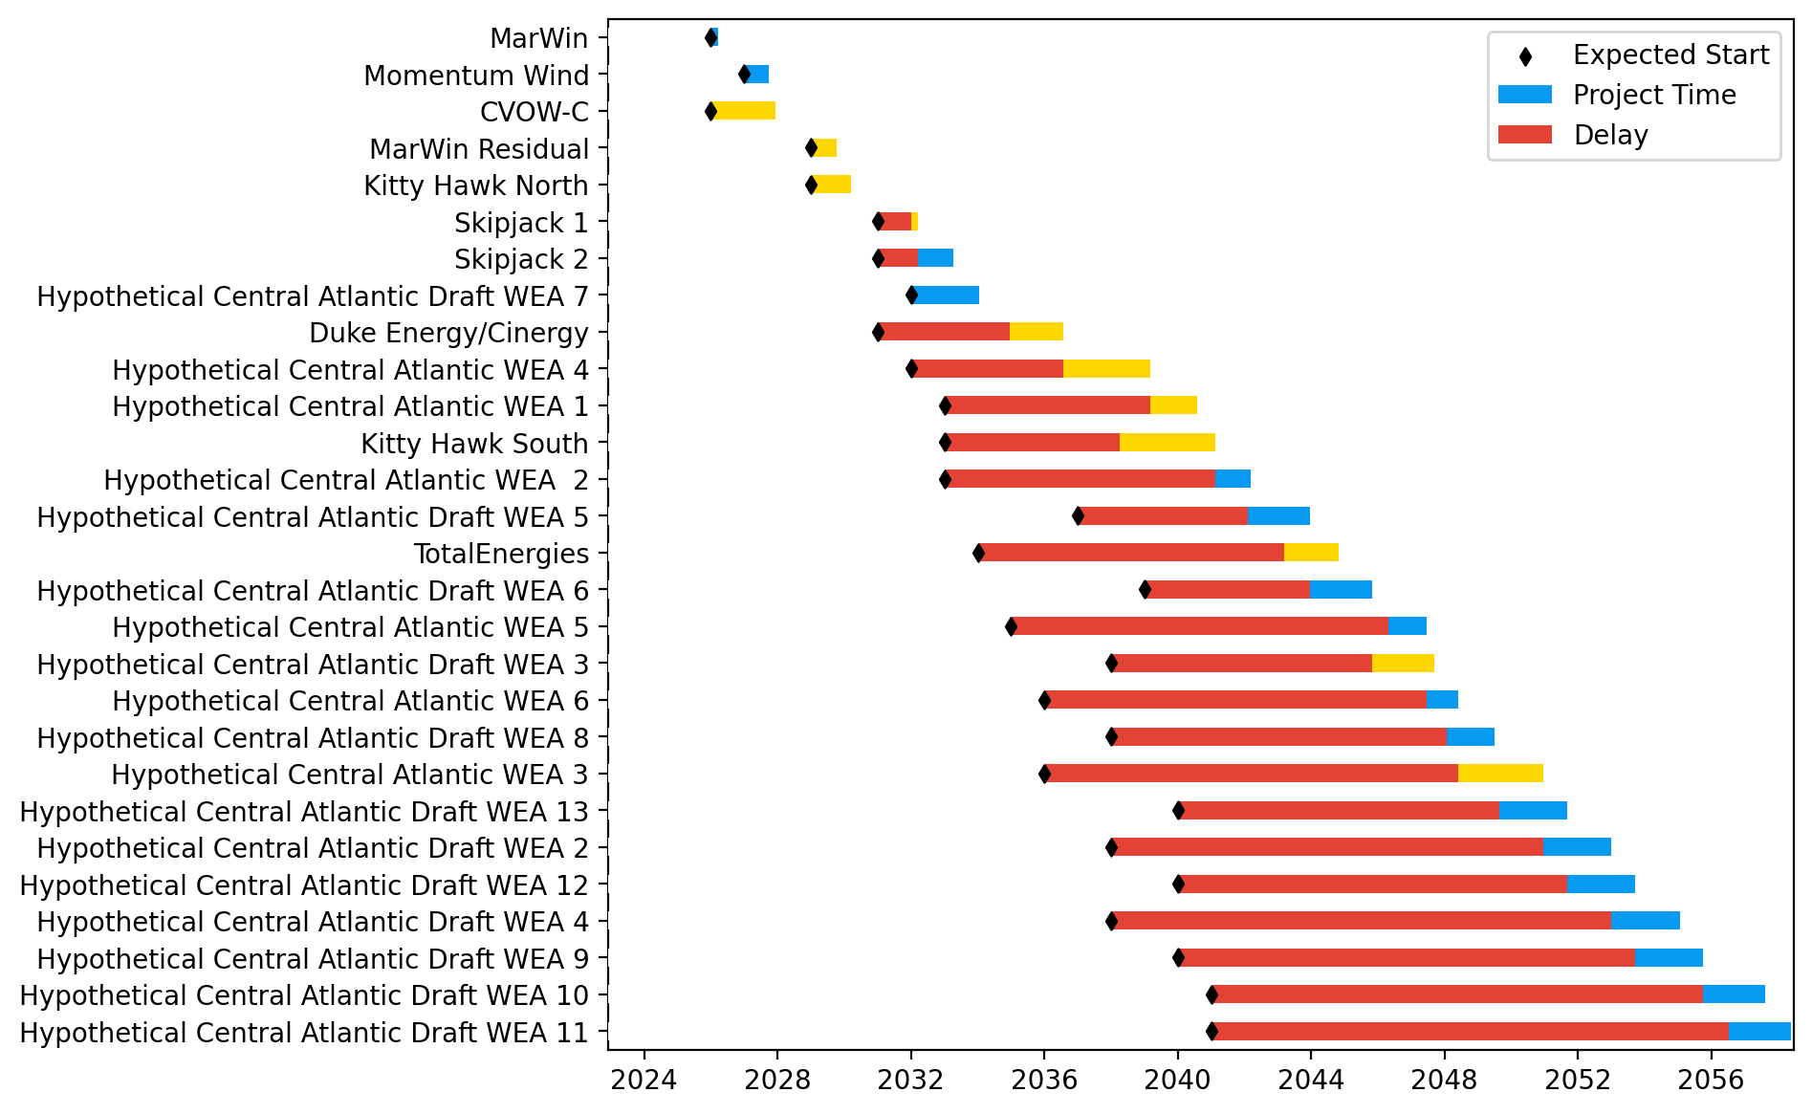
Midatlantic Gantt

Slide 9
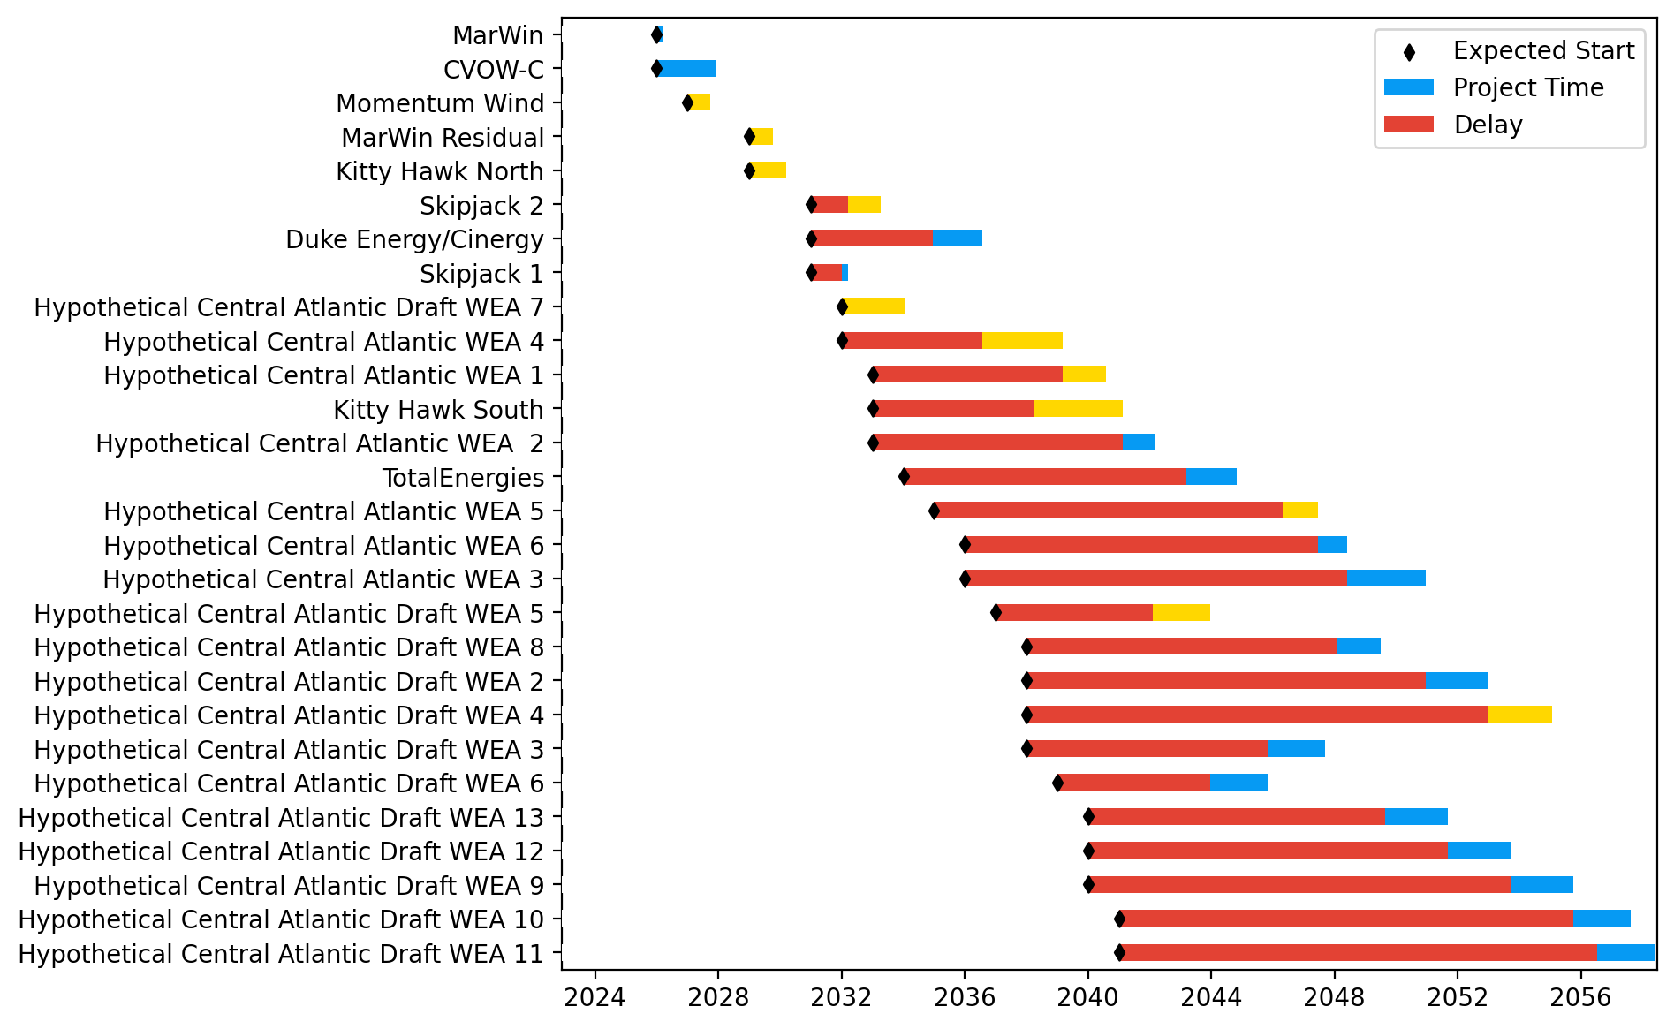
Sorted Midatlantic Gantt

Slide 10
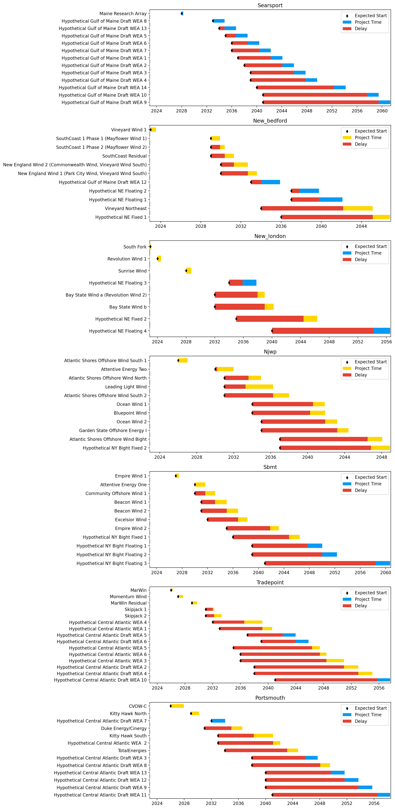
Port Gantts

Slide 11
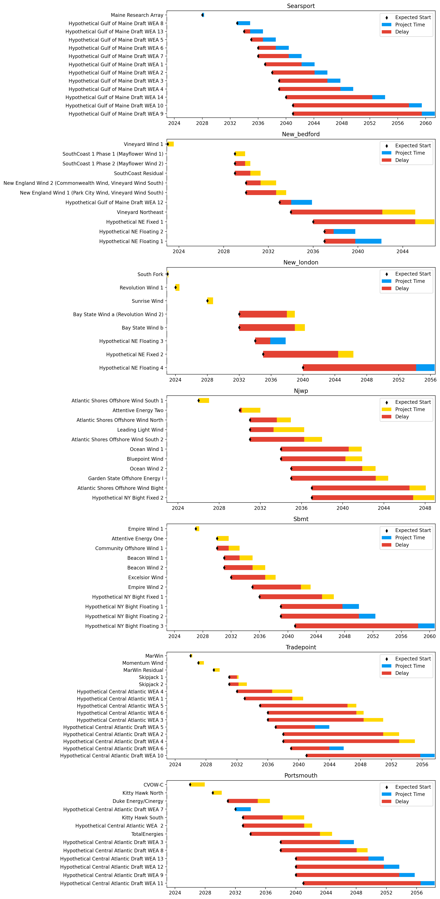
Sorted Port Gantts

Slide 12
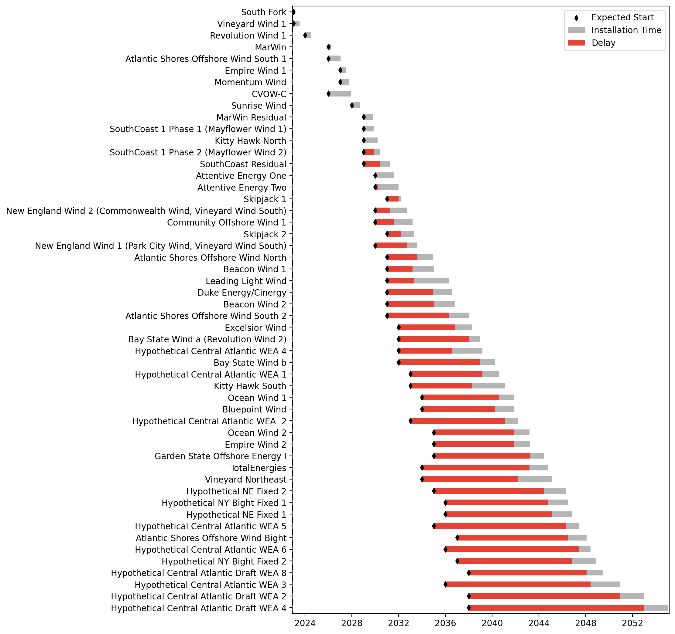
Fixed Gantt

Slide 13
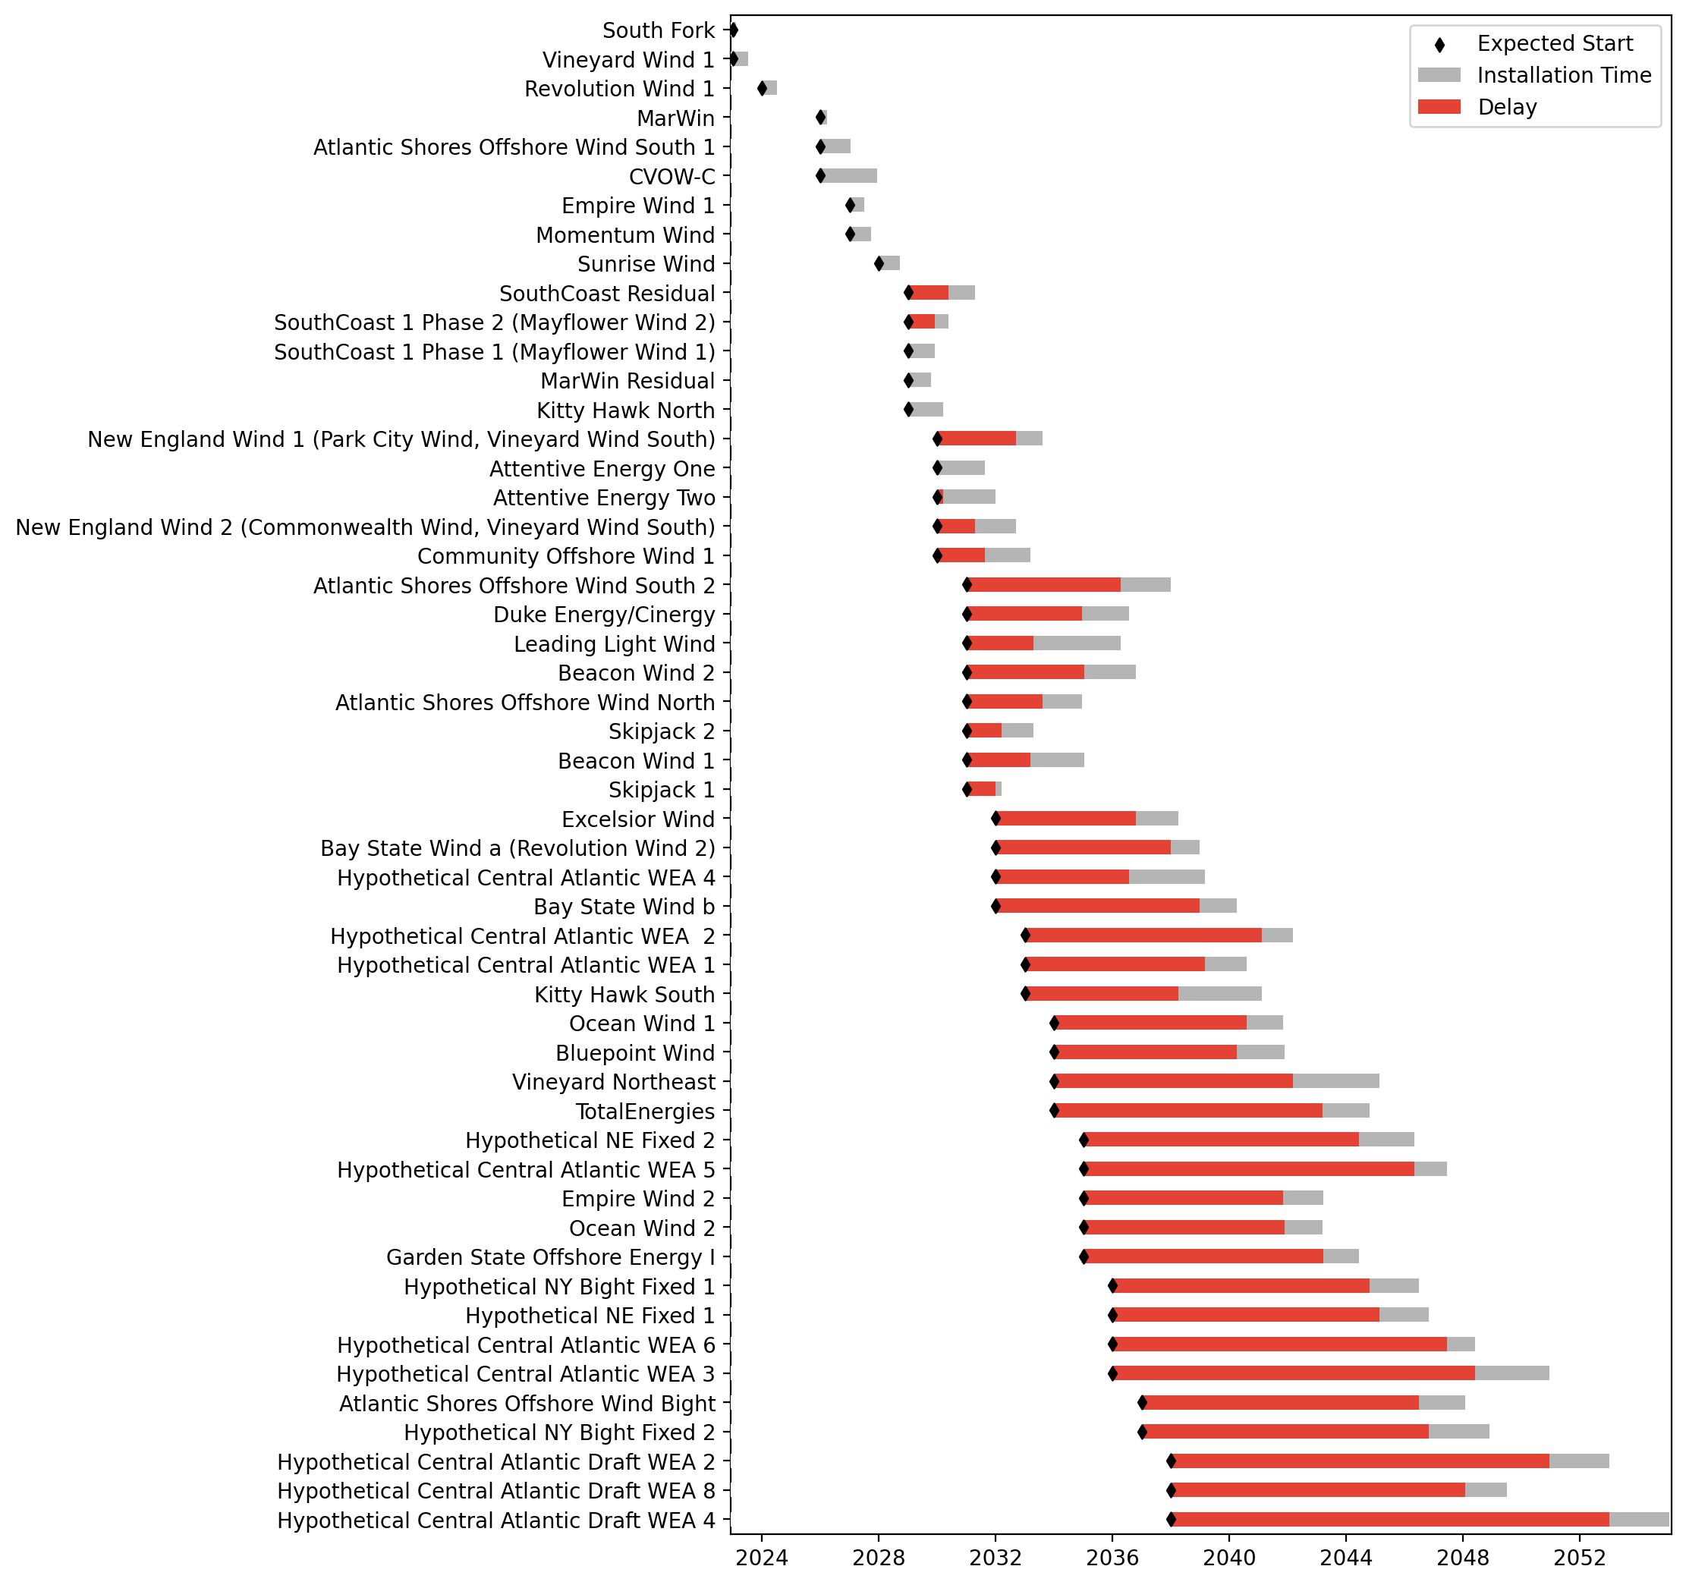
Sorted Fixed Gantt

Slide 14
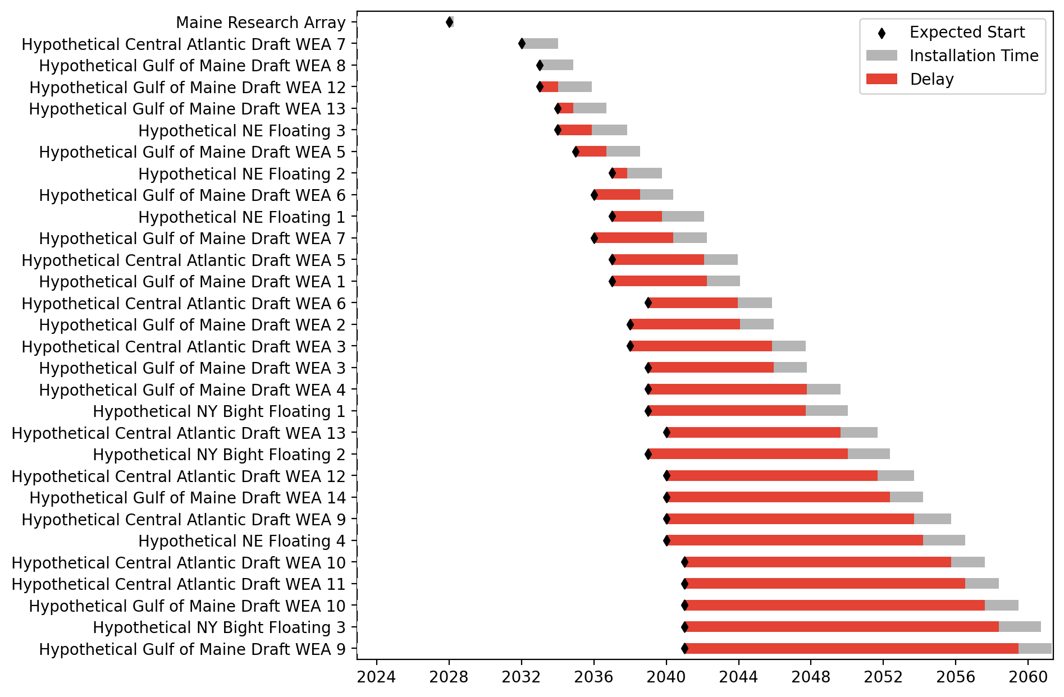
Floating Gantt

Slide 15
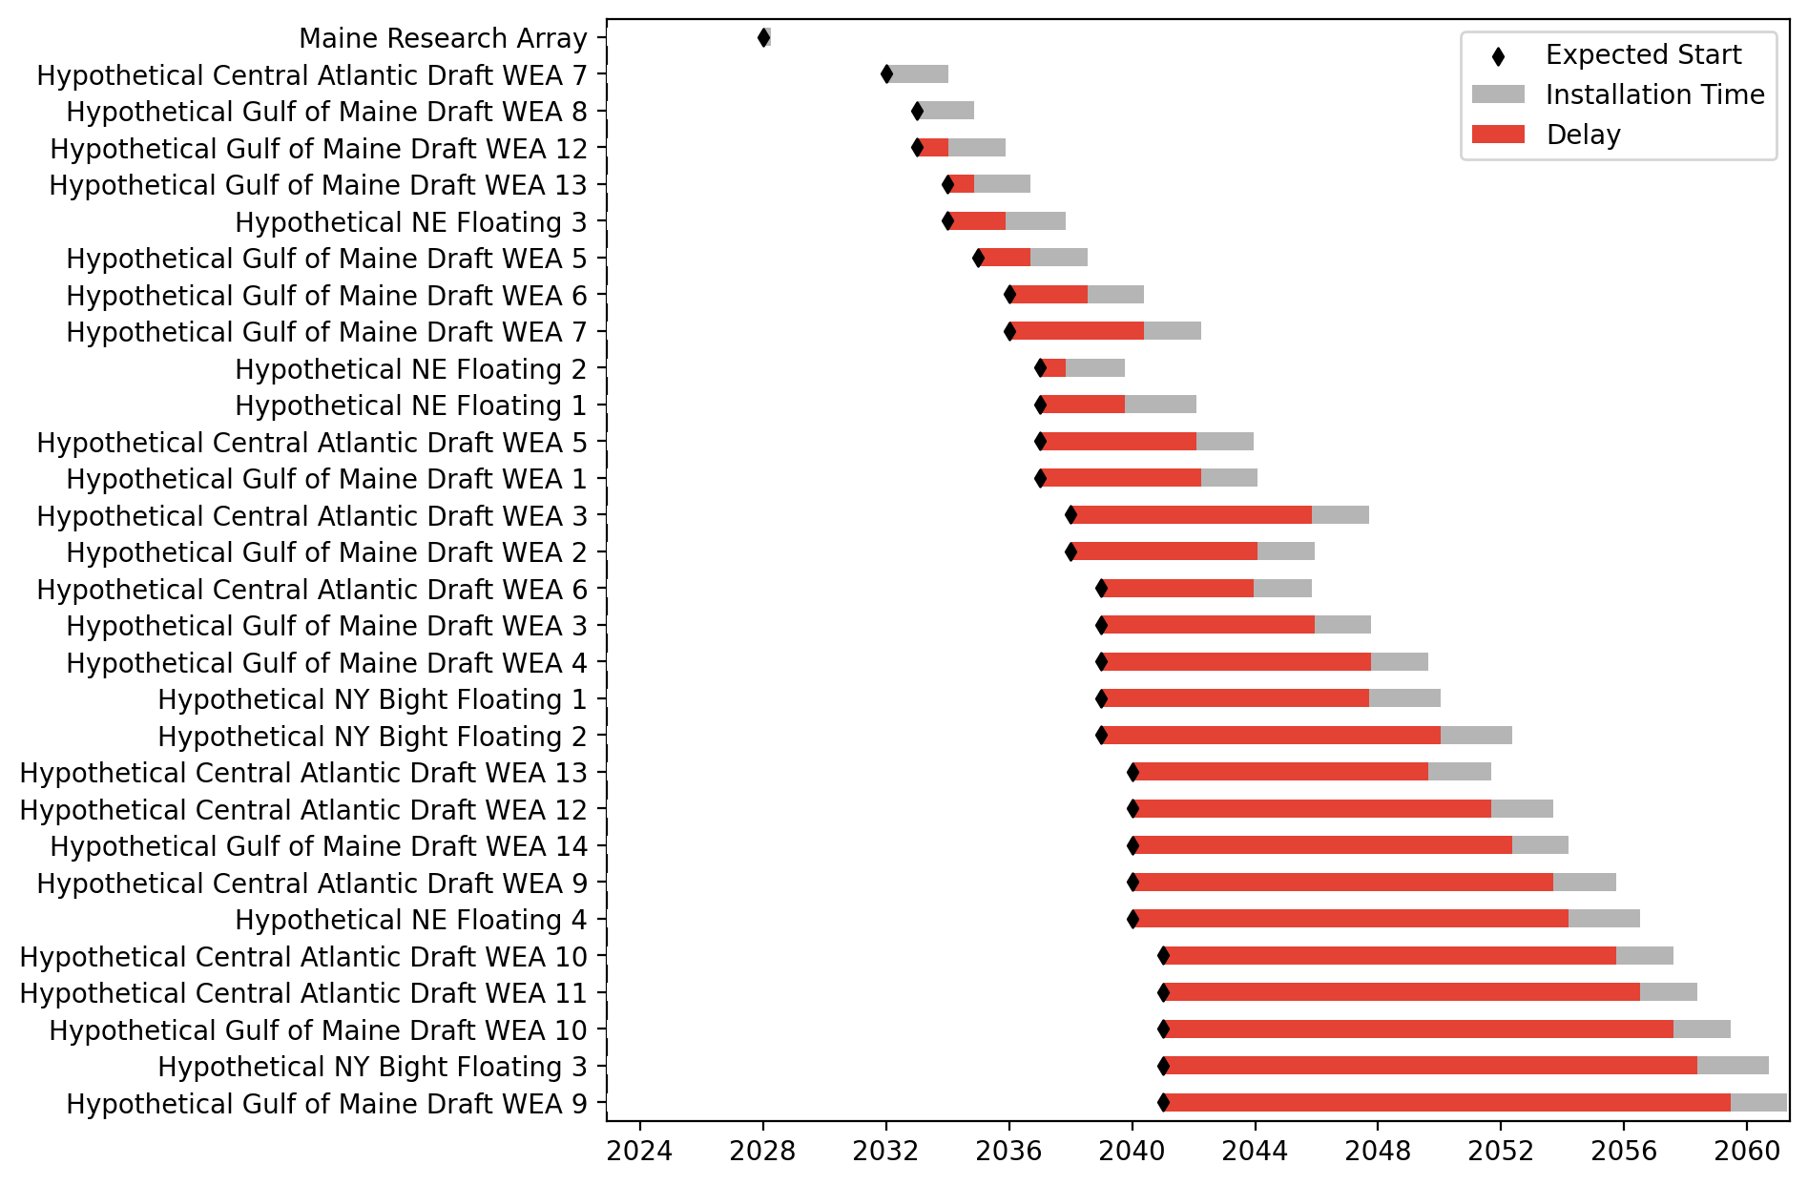
Sorted Floating Gantt

Slide 16
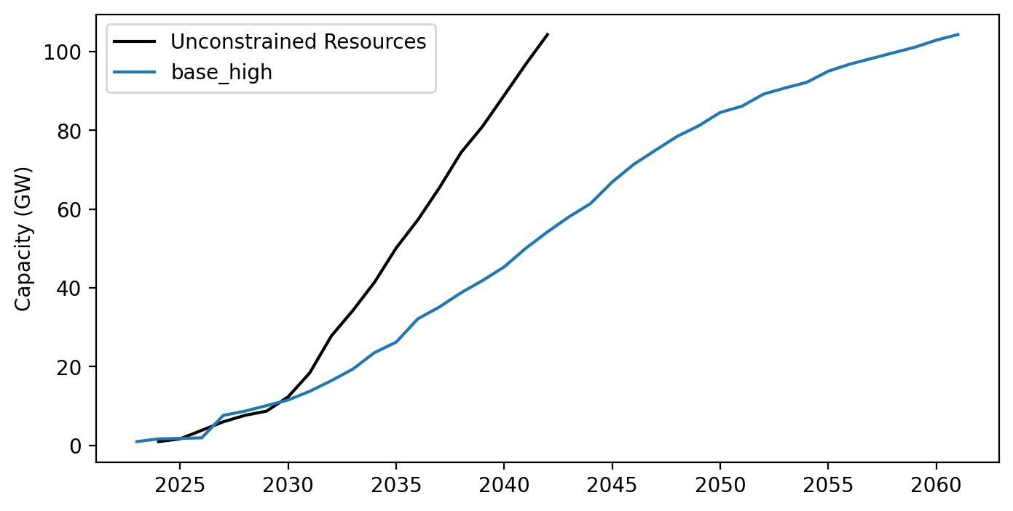
Cummulative Installed Capacity

